Slide 1
Masters Thesis Defense
Rich Cloud-Based Web Applications with CloudBrowser 2.0
Xiaozhong Pan
April 28th, 2015

Slide 2
Outline
Background
Web Applications
CloudBrowser 1.0
Design and Implementation of CloudBrowser 2.0
CloudBrowser 2.0 Implementation
Nodermi : An object-oriented RPC framework for node.js
Evaluation
Related Work
Conclusion
Notes:
my thesis topic is cloudbrowser2.0, cloudbrowser is a server-centric web framework, we will first discuss web applications and the original implementation of cloudbrowser, that is where i get started. and then we will discuss my work, the design an implementation of cloudbrowser2.0, in particular, we will discuss an RPC framework we built for this project, nodermi. After that, we will discuss the evaluation we conducted for this work, and then we compare cloudbrowser2.0 to some related work
started out with cloudbrowser 1.0,

Slide 3
Web Applications
Easy to deploy, support multiple platforms, better data management
Wide variety of applications
IDE, Instant Messager, Customer Support …
More and more native applications move to the cloud (web)
iWork —> iWork @ iCloud
Microsoft Office —> Microsoft Office online
Whatsapp —> Whatsapp web
…
Notes:
why we are interested in web frameworks
cloud9, hangout, zendesk
IBM Rational …

Slide 4
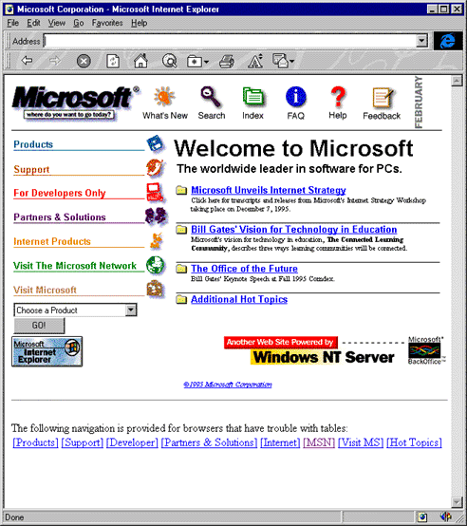
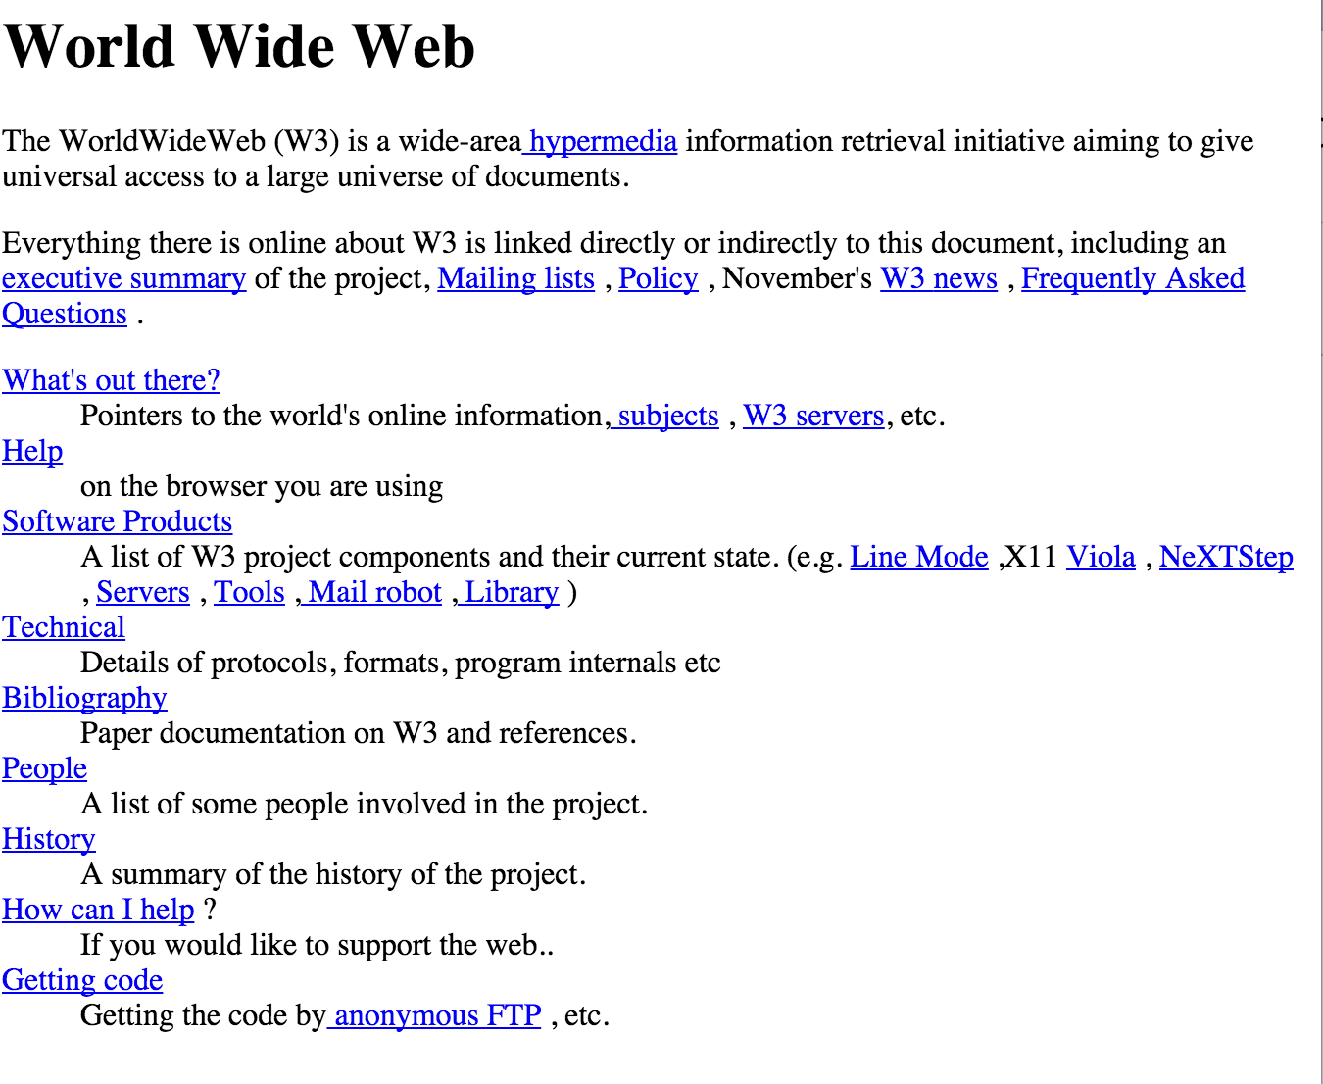
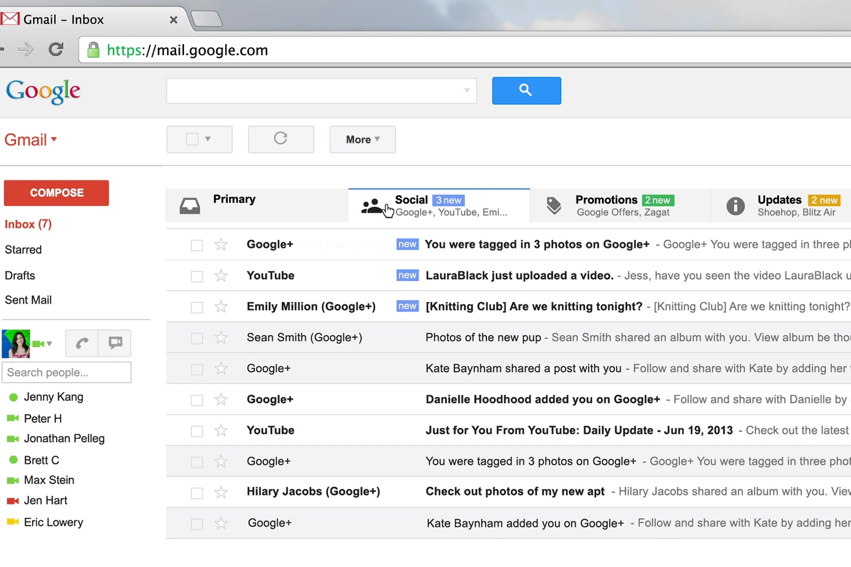
Web Application History
In-Cloud Applications?
Seamless access
CloudBrowser
Rich Internet Applications
Ajax
Client side MV* frameworks : Backbone, Ember, …
2004
Simple Interactive Applications
JavaScript, jQuery, PHP,…
1995
Static Pages
HTML
1990
Notes:
simple client side validation
simple interactive elements
TODO put year
1990
1995 Although it was developed under the name Mocha, the language was officially called LiveScript when it first shipped in beta releases of Netscape Navigator 2.0 in September 1995, but it was renamed JavaScript[11] when it was deployed in the Netscape browser version 2.0B3.[12]
In 1998, Microsoft Outlook Web App team implemented the first component XMLHTTP by client script.
In 1999, Microsoft used its iframe technology to dynamically update the news stories and stock quotes on the default page for Internet Explorer,[5] and created the XMLHTTP ActiveX control in Internet Explorer 5, which was later adopted by Mozilla, Safari, Opera and other browsers as the XMLHttpRequest JavaScript object.[6]
Google made a wide deployment of standards-compliant, cross browser Ajax with Gmail (2004) and Google Maps (2005).[8] In October 2004 Kayak.com's public beta release was among the first large-scale e-commerce uses of what their developers at that time called "the xml http thing".[9]
The term "Ajax" was publicly stated on 18 February 2005 by Jesse James Garrett in an article titled "Ajax: A New Approach to Web Applications", based on techniques used on Google pages.[3]
On 5 April 2006, the World Wide Web Consortium (W3C) released the first draft specification for the XMLHttpRequest object in an attempt to create an official Web standard.[8]
cloudbrowser 2012
incorporate the power of cloud computing, put representation state in cloud
Apple's Continuity like experience
Seamless switch to any device and the application presents the view where the user has left
as time goes on, the web applications become more and more powerful, the frameworks libraries become more and more sophisticated
Static Pages
HTML, CSS
Simple Interactive Applications
Simple client side validation; Page refresh when client server exchange data
PHP, JSP, javascript, jQuery
Rich Internet Applications
AJAX, partial page rendering
Native application like experience
Client Side MV* Frameworks: Angular, Backbone, Ember, etc. Client Side Template Engine: Handlebars, Mustache, Hogan, etc.
In-Cloud Applications?
Seamless switch to any device
Apple's Continuity like experience
CloudBrowser

Slide 5
CloudBrowser1.0 [McDaniel/Back 2012]
Execute application code and maintain presentation states on server side
Use web browsers only as HTML rendering devices
Framework provides the server side execution environment, server-client communication and client rendering
Notes:
cloudBrowser is a web framework that is built for next generation web applications, it is introduced in 2012
Because my work is build on the original cloudBrowser, I will spend 2 minutes to discuss the original implementation as background
the basic idea about cloudBrowser is to execute application code in the server
side, and maintain the application’s representation states in the server side,
the clients’ web browsers are just HTML rendering devices to fetch the representation states from the server and render them as HTML
similar to traditional dumb terminals
the framework handles server-client communication details
existing frameworks, keep presentation server side, client connect/disconnect
put benefits

Slide 6
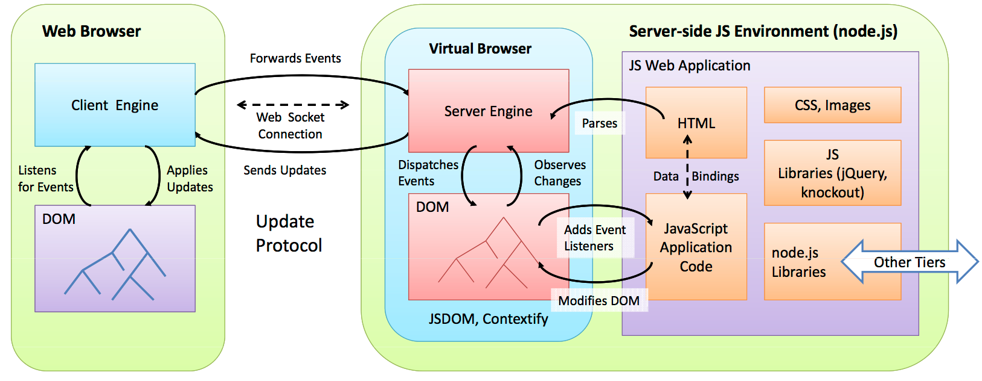
CloudBrowser1.0 [McDaniel/Back 2012]
Notes:
TODO Practice —brief
Server Side Virtual Browser
Like ordinary Web Browser, support DOM API, executes application code written in javascript
Define User Interface using HTML, CSS
Application Code can directly call server side API
Maintains DOM structure but does not do actual rendering
Client Engine : Running in Client Web Browser
Seamlessly synchronize DOM from the virtual browser and render in web browser
Forward Client interaction to the UI to virtual browser
most of the network traffic are webSocket messages, they have low overhead comparing to HTTP requests
use low over head webSocket to transmit events and DOM updates

Slide 7
Benefits of CloudBrowser1.0
Single language : application logic is entirely in JavaScript
Single place : client-server communication is abstracted away
Reuse existing technology and developer experience: javascript libraries, CSS frameworks
Continuous experience for user
Notes:
6:00
single language, the whole application can be written entirely in javascript, there is no need to write the user interface in javascript and have another server side language such as java, php
Application code is running in virtual browser, for the developers, there is no need to write client-server communication code, that is handled by the framework
the application can be written in the same way as writing a web page, there is no framework specific ui mark up language, the application use only javascript, css, html, the things developers are already familiar with, and they can use existing client side technologies, such as bootstrap, jQuery, angular,..
CloudBrowser also automatically provides continuous experience for users without additional development effort, the users can connect to the application and continue from where they left last time

Slide 8
Open Problem for CloudBrowser1.0
Problem | Solution
Unsuitable for PaaS deployment | Application bundle
Lack of way to share data across virtual browsers | App instance
Lack of virtual browser management | Application Instantiation Strategies
Non-scalable, single-process implementation | Multi-process implementation
Lack of isolation for applications | Encapsulated API layer
Notes:
there are some open problems of the original cloudBrowser implementation, my work addresses these problems.
our goal is to provide a PaaS service where developers can deploy their applications and let cloudbrowser to host the application and the application is automatically scalable
First we need to provide a way for developers to define applications,
our solution is application bundle
then we need to provide a method to let virtual browsers share data directly,
our solution is app instance
then we also need to provide applications the ability to specify how they want to create virtual browsers,
that is addressed in application deployment model
we also want to address the scalability problem, because the original implementation is single-threaded,
we created coudbrowser2.0 for this,
finally we want to isolate applications.
we created API layer
this is covered in
application instantiation strategies,
also we want to isolate applications so that they cannot access internal objects in unexpected ways
Another problem of cloudBrowser1.0 is that it is single-process, we cannot increase its capacity by adding more CPU cores or more machines
previous work does not define when and how
my work addresses these problems
application development model,
my work addresses this issue by
PaaS ….
PaaS, roles, co-exist applications
what my work addresses
Original implementation does not provide methods to specify when to create virtual browsers

Slide 9
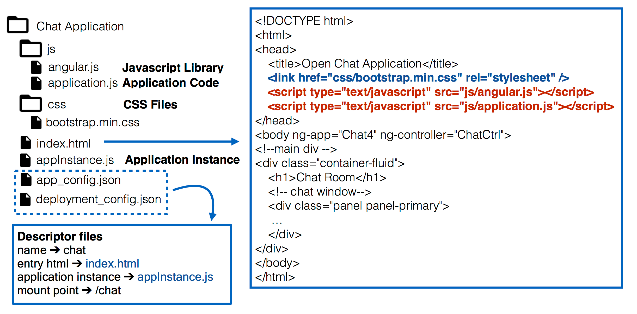
CloudBrowser Application Bundles
CloudBrowser is PaaS service, supports deployment of multiple applications
Applications are defined by application bundles
Notes:
my work in application bundle, application deployment model is built on another graduate student Ashima’s work
(the concepts were already in the code when i started, but some are not implemented, some are not implemented correctly)
Application bundle is like the concept of WAR (web application archive) in J2EE,
we use application bundles to define applications
the structure of application bundles looks like a normal html application with some cloudbrowser specific configuration files
the web developers are very familiar with this kind of structure, the development is basically the same as writing normal html pages, with a html including javascript and css files
the developers can upload application bundles using our admin interface, and the system will deploy and run the applications

Slide 10
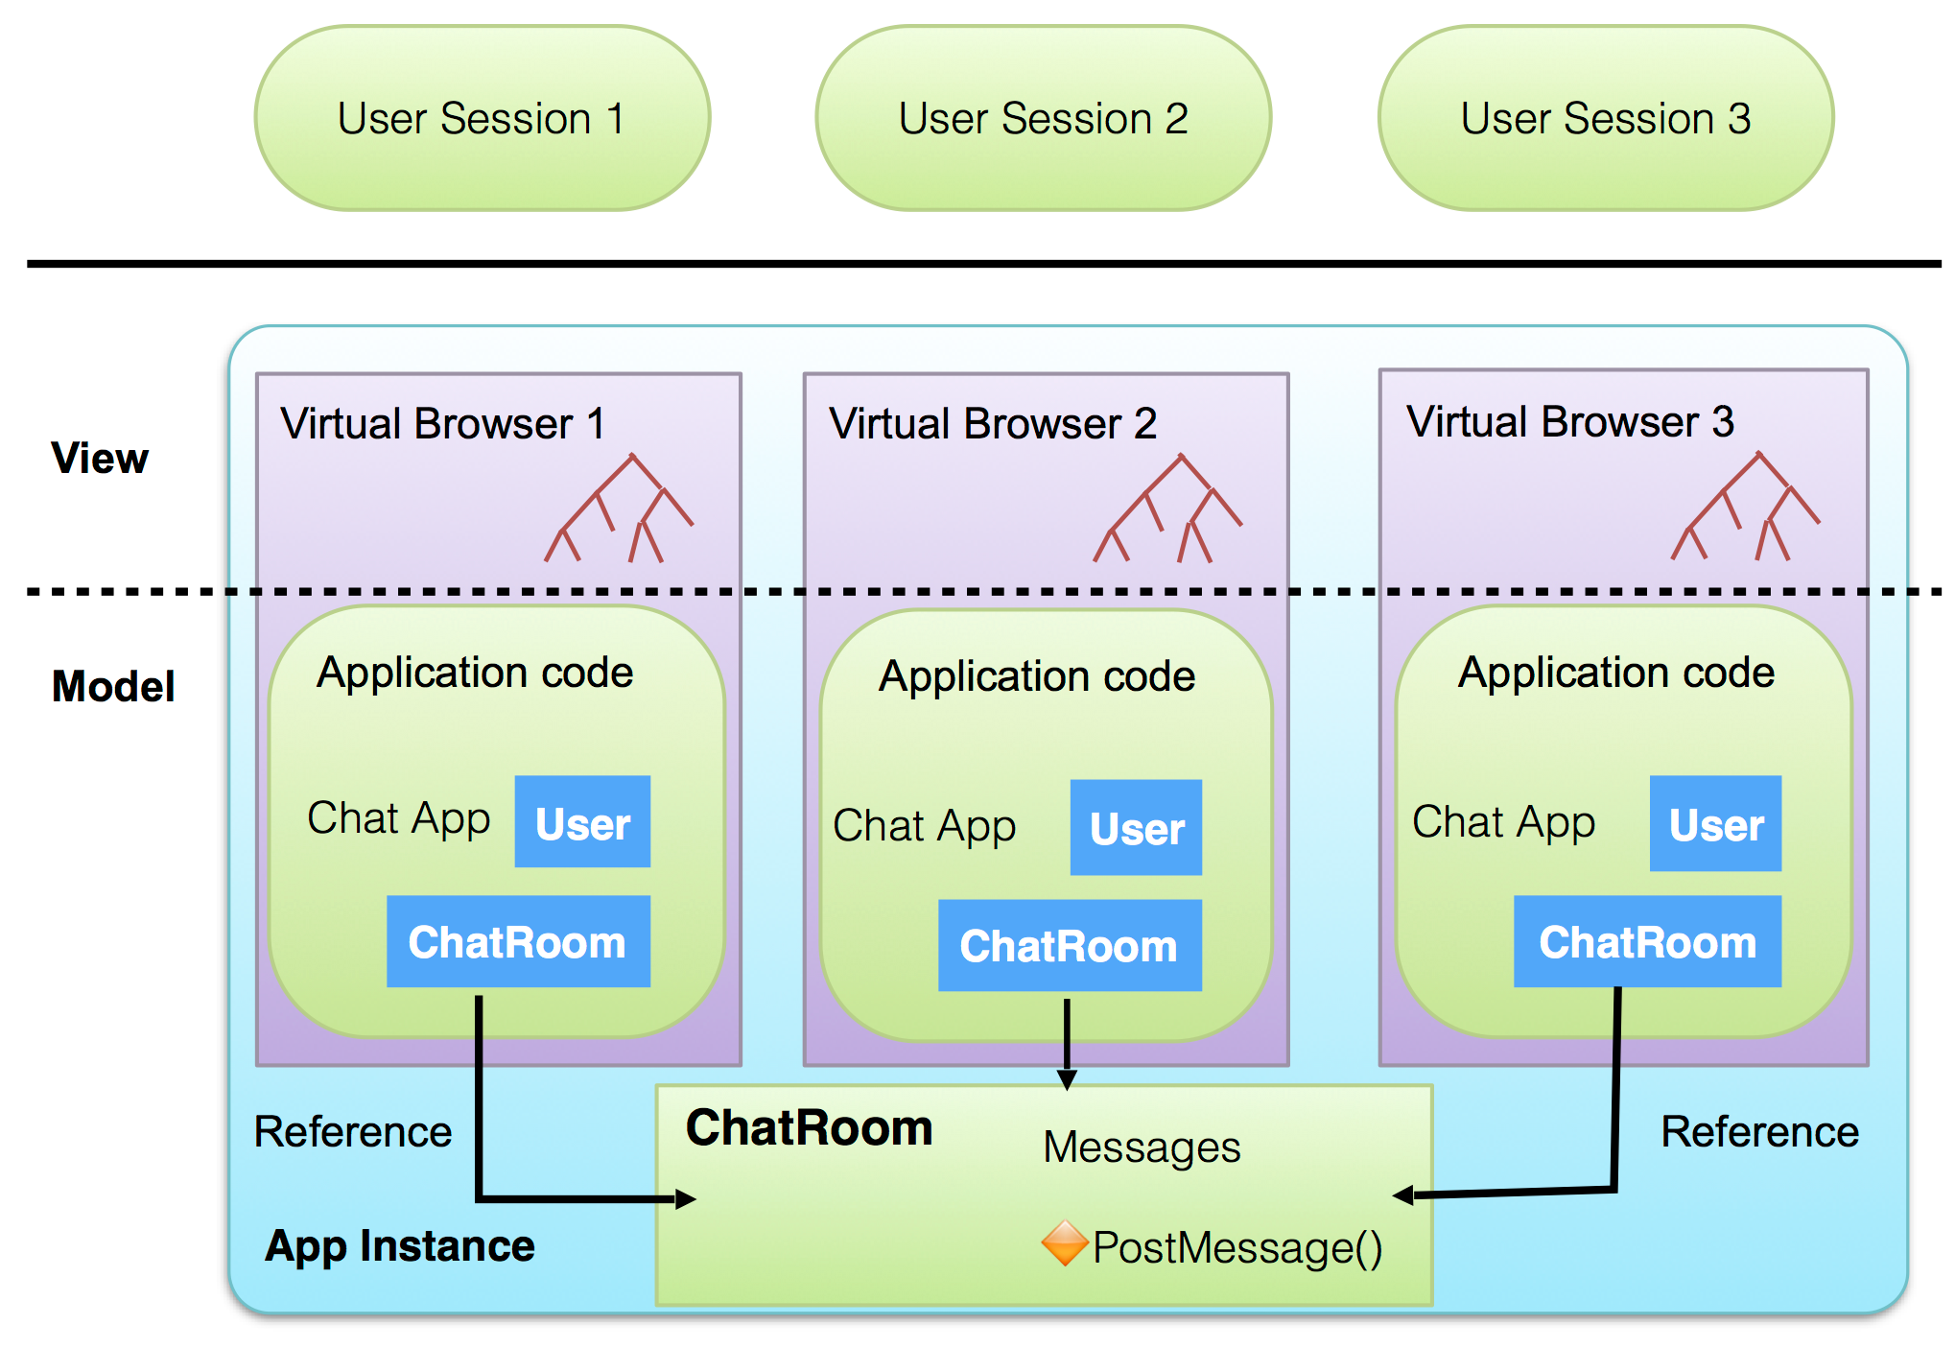
App Instance
Notes:
MVC frameworks
once an application is deployed, the application can create app instances
app instances provide a way for virtual browsers to share javascript objects directly.
Virtual browsers are isolated and they have separated namespaces,
only virtual browsers in the same app instance can share javascript object directly.
if we do not introduce app instance, virtual browsers would need use message queues or other indirect ways to share model data.
In this example, we have three virtual browsers share a chatroom object in their
app instance, each virtual browser represents a user’s view of the chatroom,
the virtual browsers can add chat messages in this chatroom object, and the changes made into the chatroom object is immediately available for all these three virtual browsers,
we need this model for javascript MVC frameworks,
we can use the shared object as the model in MVC frameworks to simplifies development,
a new user can join the chatroom by creating a new virtual browser in the app instance
we can
each virtual browser has its own namespace
app instances provide
the ability to directly share model state in virtual browsers
In one application instance, we can create multiple virtual browsers,
these virtual browsers can share model objects directly.
For example, for a chatroom application, we can use application instance to model chatrooms, so for each chatroom we create an application instance, we can define a chatroom object in the app instance to manage the state of the associated chatroom, for every user in the chatroom, they each have a separated virtual browser, each has its own DOM tree, these virtual browsers directly share the chatRoom object, they can call the chatroom object’s methods, they can use the chatRoom object directly in the user interface,
the changes made to the shared chatRoom object is immediately available for
all the app instance’s virtual browsers
new user can join an existing app instance by creating a virtual browser inside the app instance
———-
Multiple virtual browsers can share data structure
Each user’s view is a separate virtual browser
Virtual browsers in a chatroom share ChatRoom object
ChatRoom object can be directly bind to DOM trees
Changes made to ChatRoom is immediately available for the app instance’s virtual browsers

Slide 11
Application Deployment Model
Notes:
so in our application deployment model, we can have multiple applications running in a cloudbrowser installation …
most general model first —— landing page —- user manage vbs
——> strategies —- singleBrowserPerUser
TODO add another slide to discuss scenarios
screeshot of landing page

Slide 12
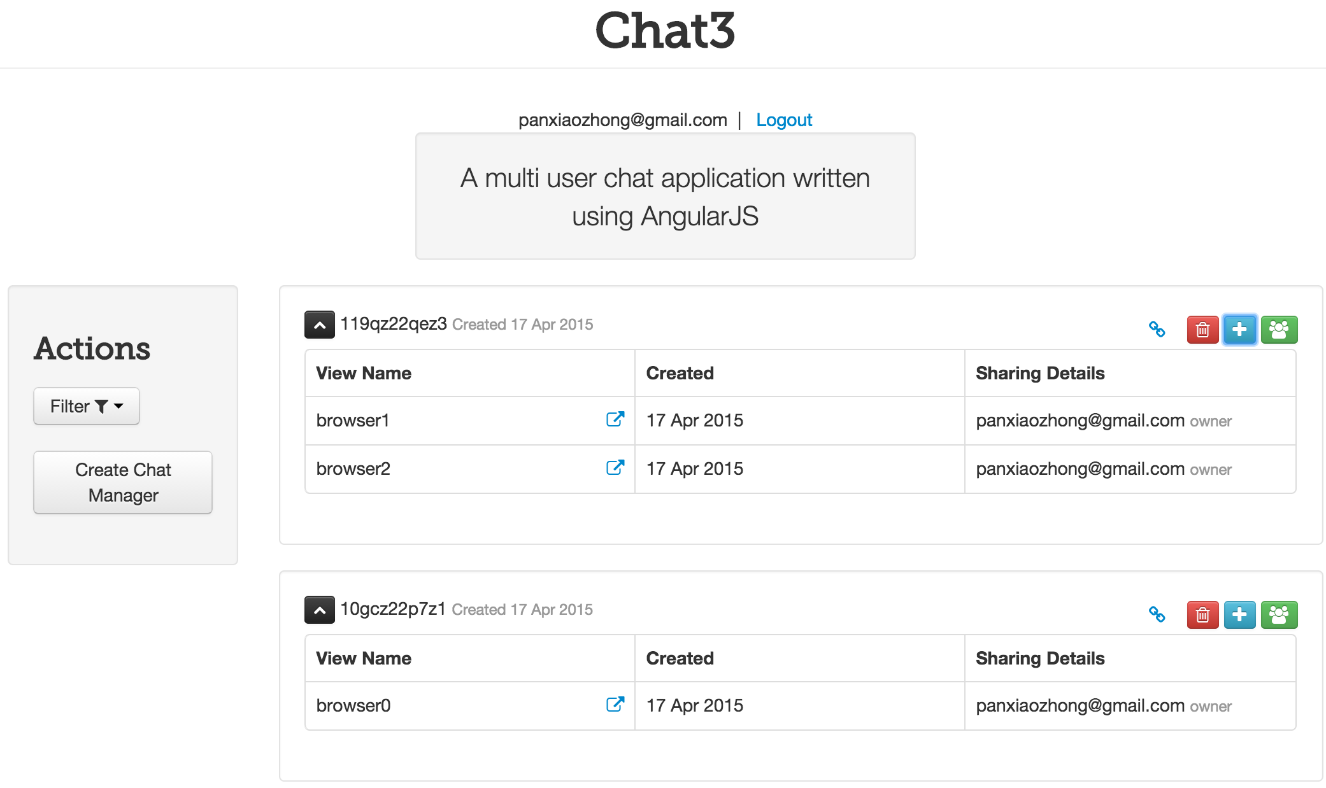
Application Management
Landing Page : user interface to manage app instances and virtual browsers
Notes:
put the pic to full page, delete text
most flexibility
since a user can create multiple app instances and multiple virtual browsers,
The user needs to choose which app instance and virtual browser he wants to connect,
we provide the landing page for users to manage his app instances and virtual browsers in an application
the user can create new app instances or virtual browsers, or connect to existing virtual browsers using this interface

Slide 13
Application Instantiation Strategies
multiInstance : most flexible model
singleBrowserPerUser : multi-user applications, e.g. chatroom
singleInstancePerUser : single-page style applications
singleAppInstance : non-interactive information page, e.g. weather
Instantiation Strategy | Number of App Instances | Number of Browsers Per App Instance | User Manages App Instance | User Manages Virtual Browser
multiInstance | any | any | Yes | Yes
singleBrowserPerUser | any | 1 per user | Yes | No
singleInstancePerUser | 1 per user | 1 total | No | No
singleAppInstance | 1 total | 1 total | No | No
Notes:
creating multiple instances per user and creating multiple virtual browsers per instance provides the largest flexibility for user,
but applications may want to add more restrictions.
for example, for a single-page application, each user has only one single view, the application need to restrict the user to create only one virtual browser,
we provide four instantiation strategies for different types of applications,
for example, using the singleBrowserPerUser option, a user can create multiple app instances, in an app instance, each user can only create one virtual browser,
we can use this option to create chatroom application, where a user can create multiple chatrooms but he can only have one chat window inside any given chatroom.
For the users that are merely joining existing chatrooms, they are not aware of the concepts of app instances and virtual browsers, they are automatically directed to their associated virtual browsers

Slide 14

Application Deployment Model
Chat Application
http://example.com/chat
singleBrowserPerUser
redirect to landing page
App Instance 1
Landing Page
Virtual Browser 1
Virtual Browser 2
share chatroom http://example.com/chat/a/1
http://example.com/chat
http://example.com/chat/a/1
create chat room
For users that merely join existing app instances, they do not need to manage virtual browsers

Slide 15
Goals for CloudBrowser2.0
Address open problems in CloudBrowser1.0
Implement application deployment model: application bundle, app instance concept, application instantiation strategies
Scalable on SMP and cluster
Isolate applications
Leverage existing implementation
Notes:
since we have defined the application deployment model, we go on to discuss the implementation of cloudBrowser2.0.
There are four goals for cloudBrowser2.0, first
it needs to be scalable on a SMP machine or on a cluster of machines,
second, we need to implement the application deployment model and provide a way to isolate applications, finally, we want to reuse the existing code base as much as possible, we do not want to delete everything and start from scratch

Slide 16
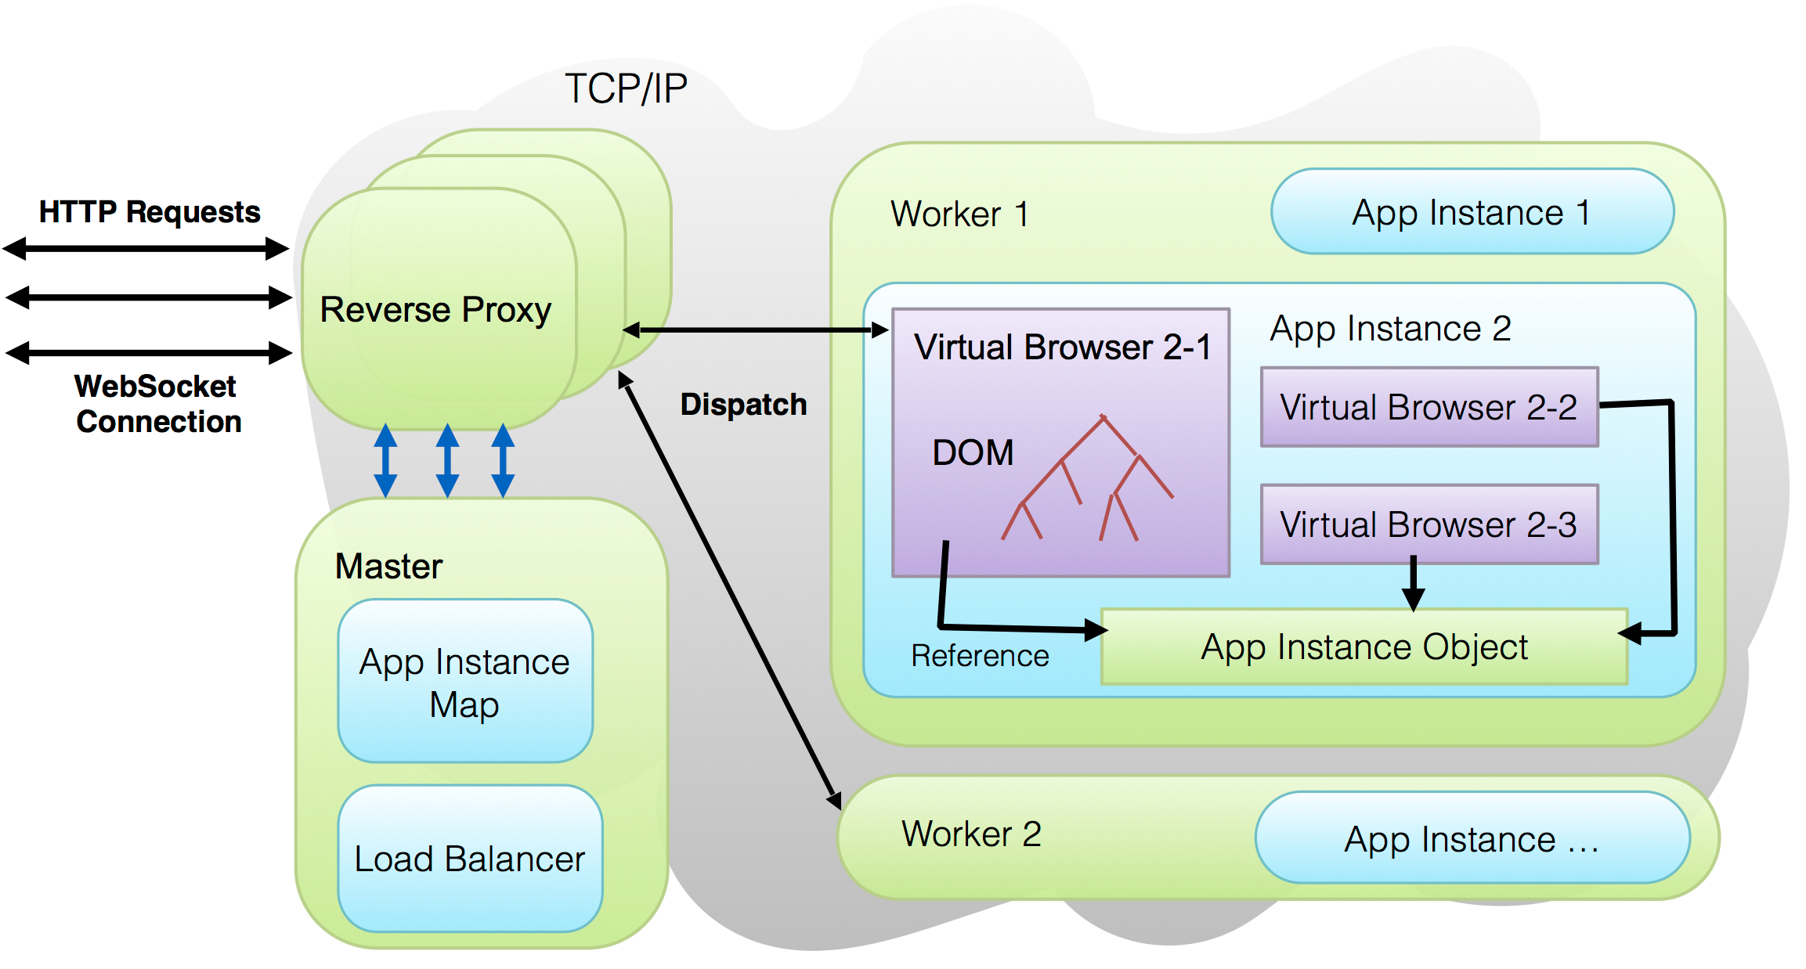
CloudBrowser2.0 Architecture
Notes:
Here is the overview of cloudBrowser2.0 architecture.
we have one master process, multiple reverse proxies and multiple worker processes.
The worker processes provide application execution environment, they host app instances and virtual browsers
the reverse proxies dispatch user requests to the workers
the master controls reverse proxies
the master is a single point of failure,
in our system, most of the network traffic are webSocket messages , the master process is contacted by reverse proxies for new connections, once a connection establishes the messages are forwarded without master’s intervention ,
and the master only does simple tasks, so it is not a big problem
have almost all the features of the original cloudbrowser,
master is mainly for request dispatch logic and maintain some global application metadata, we try to keep it as simple as possible,
reverse proxies are IO intensive, deploy them using standalone processes could prevent them from interfering with the master
separation of …
make it bigger

Slide 17

CloudBrowser2.0 — Request Dispatch
http://example.com/app1
Worker 1
Reverse Proxy
round-robin
redirect to
virtual browser 1
app instance 1
virtual browser 1
created
http://example.com/app1
ask for destination
Reverse Proxy
find an app instance
to worker1
redirect to
virtual browser 1
Master
Worker 2
App Instance 1
create app instance
Virtual Browser 1
Notes:
TODO goals, separation of master of reverse proxy
In this example, the user tries to connect to an application, a reverse proxy accepts this request, the reverse proxy is picked up by OS in a round-robin fashion, then the reverse proxy asks the master where to forward this request, since the master cannot extract application instance information from the request’s URL now, the master picks a worker using the load balancing algorithm to handle this request, here, worker 1 is picked, then worker 1 asks the master to find an app instance for this user, since there is no app instance right now, the master pick a worker to create a new app instance, here worker 2 is picked, and then the system will tell the user to redirect to the new app instance and virtual browser
Requests to an app instance must be routed to the worker that hosts the app instance
The master keeps mapping of App Instance Id to workers
Extract app instance id from request URL
The mapping is updated when new App Instances are created or App Instances are removed
If the URL does not contain app instance id, the master picks a worker using the load balancing algorithm

Slide 18
CloudBrowser2.0 — Request Dispatch
Worker 1
Reverse Proxy
http://example.com/app1/a/1/b/1
round-robin
Reverse Proxy
initial HTML
to worker2
Master
ask for destination
Worker 2
initial HTML
App Instance 1
Virtual Browser 1
Notes:
TODO : overhead …
when the user is redirected, his browser sends a new request with the virtual browser’s url, the URL contains the app instance id,
the master can extract the app instance id from the URL and look it up in its mapping table, this app instance id is associated with worker 2, so worker 2 is selected
then a web socket connection will be established between the user, the reverse proxy and worker 2, all subsequent messages will go through the connection

Slide 19
CloudBrowser2.0 — Load Balancing
Round-robin: assign new requests to workers in round-robin fashion
Load-based
Workers periodically report their load to the master
Master selects the worker with the lowest load
To handle bursts of requests, master projects impact on selected worker’s load
Notes:
Round-robin : place new load to workers in round-robin fashion
this could lead to uneven load distribution if the new requests vary greatly in resource consumption
another mode is Load based,
in this mode, workers periodically report their load (heap memory used) to the master
Master selects the worker with the lowest load
Since the master’s knowledge of the worker’s load is not up-to-date,
the master makes a projection of the worker’s future load after the master place a new request on that worker, and use the projected value (as the worker’s load) until the master receives a new load report from that worker
with this enhancement, we can avoid placing all the new requests to a single worker when handling a burst of new requests
Avoid putting all the load to one worker
Every time a worker is selected, the master makes a projection of the worker’s load after the new load is placed to the worker, the projected value is used as the worker’s load value until new load report from the worker is received
too much text
Handle bursts of new requests
The master’s knowledge of the worker’s load is not up-to-date
Avoid putting all the load to one worker
Every time a worker is selected, the master makes a projection of the worker’s load after the new load is placed to the worker, the projected value is used as the worker’s load value until new load report from the worker is received

Slide 20
CloudBrowser2.0 — Load Balancing
App Instance 1
App Instance 3
Master
Weight Table
App Instance 2
App Instance 4
worker1 | worker2 | event
90 | 100 | init
90 | 100 | place app instance1
100 | 100 | select worker1
100 | 100 | place app instance 2
110 | 100 | select worker1
110 | 100 | place app instance 3
110 | 110 | select worker2
98 | 100 | worker1 reports 98
98 | 100 | place app instance 4
108 | 100 | select worker1
Worker 1
load : 98
App Instance 1
App Instance 2
App Instance 4
Worker 2
App Instance 3

Slide 21
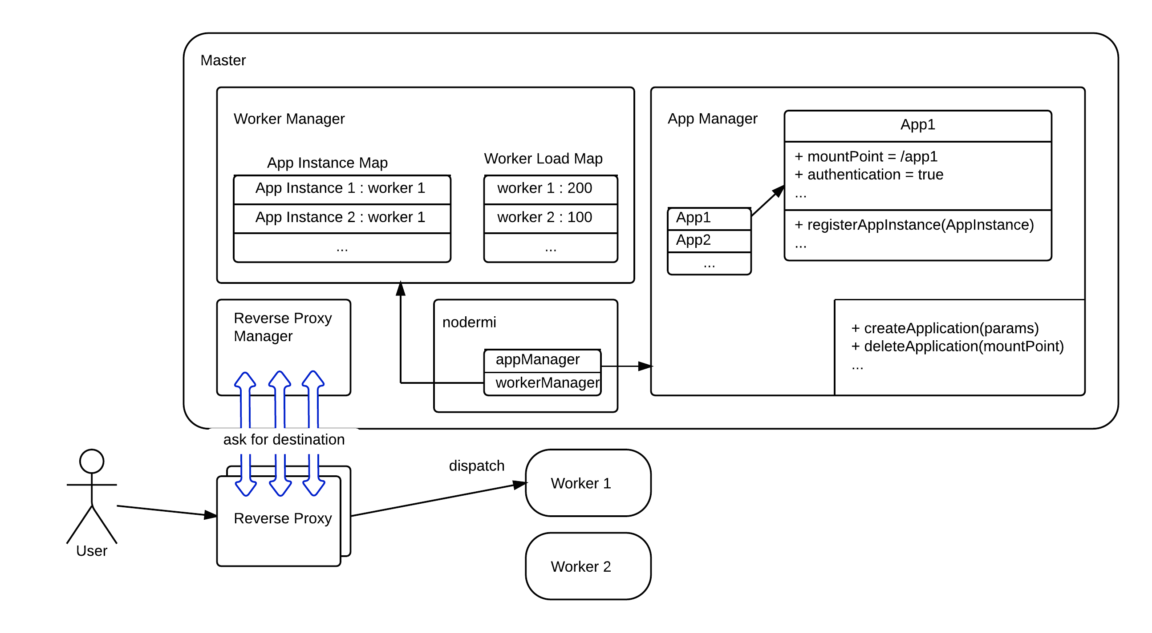
CloudBrowser2.0 — Master Implementation
Reverse Proxy Manager : starts reverse proxies, handles communications with reverse proxies
Worker Manager : request dispatch
App Manager : Manage applications’ state
Notes:
app Manager reads application bundles from file system and creates data structure to represent application metadata
worker manager and app manager are exposed to workers via nodermi
, workers call createApplication, deleteApplication remotely to …
workers call workerManager’s methods remotely to register them, report load

Slide 22
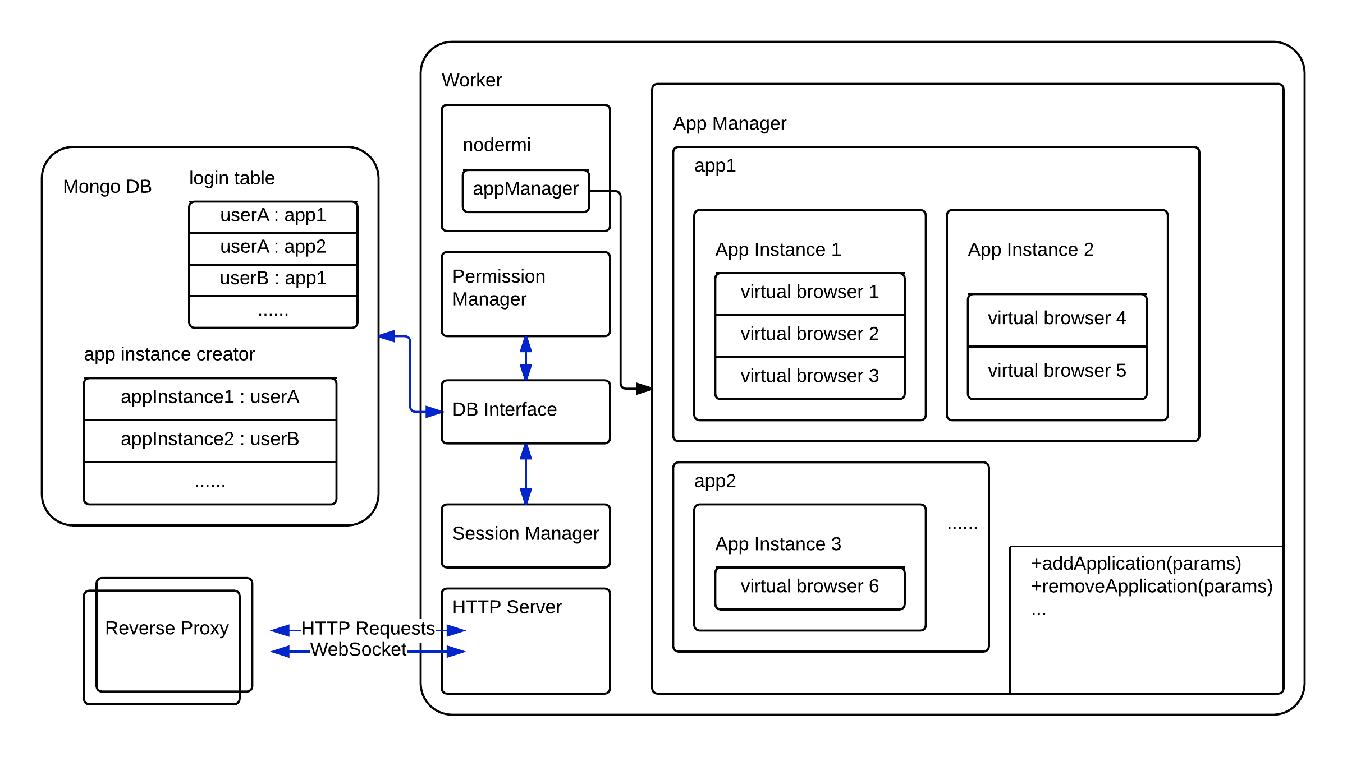
CloudBrowser2.0 — Worker Implementation
App Manager : manages local app instances and virtual browsers
HTTP Server : parses requests, find application objects to serve the requests

Slide 23
CloudBrowser2.0 — API Layer
The API layer using indirection to accomplish:
Security: enforce permission checks
Isolation: prevent application code from manipulating internal objects in unexpected ways
Stability: allow changes in framework implementation without breaking applications
Resource Reclamation: prevent application code from holding direct references to internal objects
Notes:
here we discuss how we isolate applications from framework internal objects,
we create cloudBrowser API as a level of indirection to achieve this isolation.
The application can only access internal objects through API, so it cannot manipulate internal objects in unexpected ways.
Besides that, the API layer also provides other great features,
first, the API layer make it impossible for application code to get around of permission checking, for example in our system only administrator user can shutdown an application,
it also decouples applications from framework internals, so we can update framework without breaking applications, finally, it prevents application code hold references to internal objects and vice versa, so the internal objects can be garbage collected after they are discarded by the framework
Applications need to access internal objects
Administrator Applications : upload/unload application, enable/disable authentication…
Other Applications : create/destroy App Instances and virtual browsers

Slide 24
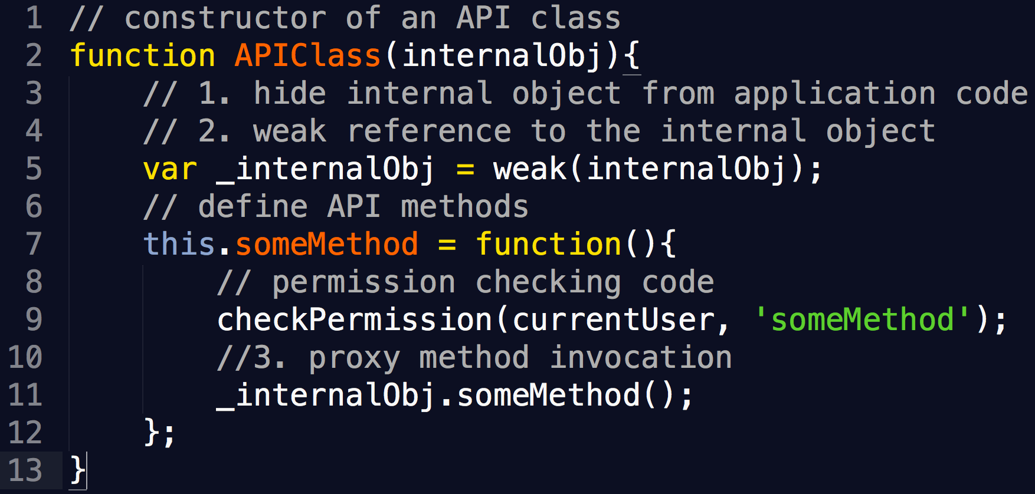
CloudBrowser2.0 — API Layer
Notes:
API 2-3 minutes
This is an example of the constructor of an Api object, an api object is basically a proxy to a internal object, it wraps around the method invocations to the internal object with permission checking code.
it also hides reference to internal object from application, in this example, the reference to the internal object is defined inside the api object’s constructor, and the api object’s methods are also defined inside the constructor, so the application code cannot obtain references to the internal object while the api code can reference it since they are in the same closure.
Also, the api use weak reference to internal objects so the internal objects can be garbage collected even they are referenced by the API
we hide the internal object from application code
the internal object is reachable from the API methods
because the internal object is referenced as an local variable inside the constructor and the API methods are defined inside the constructor
but the application code cannot see the reference to internal object, it can only
use the API class’s methods
2. API layer references the internal objects using weak references TODO…
no direct access
API cleans internal objects’ references to objects created by applications upon closing virtual browser

Slide 25
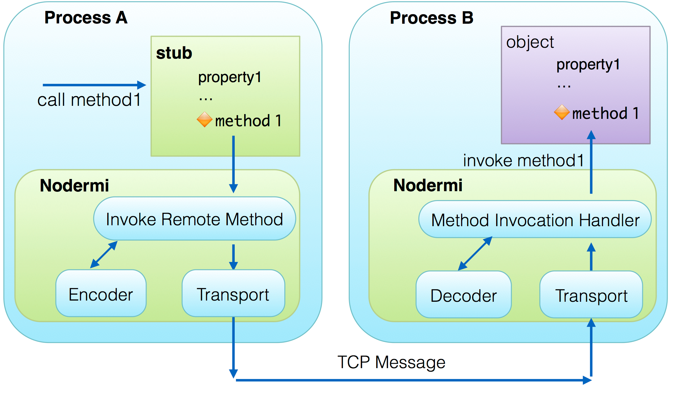
nodermi — Overview
Nodermi creates stubs to represent remote objects
Method calls on stubs trigger remote method invocations
Notes:
since we change the architecture from single process to multiple process, we need to transform local method invocations to inter-process communications,
to reuse the existing code base as much as possible,
we created an object-oriented RPC framework called nodermi to transparently transform local method invocations to remote method invocations.
although it is developed for cloudBrowser, nodermi is released separately, it is a standalone framework that can be used in any node.js project.
Like in any RPC framework, nodermi create stubs to represent remote objects, calling methods on stubs will trigger remote method invocations.
stubs are also called remote references.
nodermi first encodes the parameters of the method and other information about the method call as a message , and then sends the message to the process that holds the remote object, then that process will decode the message and invoke the corresponding method.
for programmers, all these happen transparently, the stubs appear like local objects
emphasis similarities , transparency, stubs, marshal unmarshal …
Implement inter-process communication by explicitly sending messages is undesirable
Need to change a lot of existing call sites
Need to design message formats for many different methods and write handler code to parse and process each these messages
Changes to methods require modifications to the message communication layer
We design a RPC framework
Abstract message communication as remote method invocation
Seamlessly transfer local method invocation to remote method invocation, local reference passing to remote reference passing

Slide 26
nodermi — Asynchronous Remote Method Invocation
Unlike RPC frameworks like Java RMI, remote method invocations in nodermi do not block
node.js is a single-threaded event driven platform
I/O related methods must be implemented asynchronously
Notes:
In RPC frameworks such as java RMI, a remote invocation blocks until the the process receives the result of the remote method.
In nodermi, remote method invocations are asynchronous.
because node.js is a single-threaded event driven platform, methods must not block in node.js or they block the whole process, so I/O related work must be implemented asynchronously, that is using callback functions.
In nodermi, if we want to wait for the return value of a remote method, the method needs to accept a callback function like any I/O related methods.
Unlike RPC frameworks like java RMI, when a remote method returns, the original method is not invoked yet
impact
asynchronous methods — methods that accept callbacks are common in node.js
some refactor needed

Slide 27
nodermi — Asynchronous Remote Method Invocation
stubB.method1(
function callbackA(result){
console.log(result);
}
);
var objectB = {
method1 : function(callback){
var result = importantWork();
callback(result);
}
}
stubB
objectB
🔶method1
Nodermi
Nodermi
🔶method1
Process A (client)
Process B (server)
call
Notes:
like in this example, we use a callback to get the result of objB’s method1 remotely, nodermi dynamically create stubs for callbacks, so for programmer method1 acts like an ordinary local asynchronous method.
First , nodermi calls the remote method
larger font… dynamic create stubs for callbacks
node.js is single threaded event driven platform
Methods must not block
I/O related work must be implemented asynchronously
Unlike RPC frameworks like java RMI, remote method invocations in nodermi do not block

Slide 28
nodermi — Asynchronous Remote Method Invocation
stubB.method1(
function callbackA(result){
console.log(result);
}
);
var objectB = {
method1 : function(callback){
var result = importantWork();
callback(result);
}
}
🔶callbackA
Nodermi
Nodermi
🔶stubCallbackA
Process A (server)
Process B (client)
callback
Notes:
then the remote method calls callback remotely, at last, process A gets the result,
the stub for the callback is created automatically and applied to the objB’s method1 like an ordinary local function

Slide 29
nodermi — Passing Arguments to Remote Methods
Serialize
Create a stub of objectA
Call a method of stubA
Pass by reference
Automatically create remote references
No IDLs, no annotations
Pass by value
Primitive types, certain built-in types
Simple objects
Customized types
Process A
Process B
stubA
objectA
Pass
Transfer …
Method Invocation
Pass By Reference
Serialize
Create a copy of objectA
Process A
Process B
objectA
objectA
Pass
Transfer …
Pass By Value
Notes:
when passing arguments to remote methods,
the arguments could be passed by reference or by value.
In the previous example, nodermi automatically creates stubs for callbacks because functions are passed by reference.
Passing by reference means creates stubs for the passed objects, these are done without IDLs or annotations.
Passing by value means creating a copy of the passed objects instead of creating remote references for them.
primitive types like numbers strings are passed by value, objects without methods and built in types like date, error are also passed by value because there is no point of calling them remotely, we also support passing customized types by value.
Here is an example, process A passes objectA by value, then objectA is serialized and transmitted to process B, and Process B creates an exact clone of objectA.
if objectA is passed by reference, then process B will create a stub for objectA, and when the stub’s methods are called, nodermi will issue remote method invocation requests to process A
as previously mentioned, nodermi creates stubs for callback functions, that is actually a special case of pass by reference,
Pass the whole object graph
Passing by value
Primitive types : number, string
Simple objects : objects with no methods
Recreate by constructors
Certain built-in types : Date, Error, Buffer, …
Customize objects that implements toConstructorArguments
Passing by reference : the remote site creates a stub to represent the object passed
The object’s properties are also passed
object graphs,
no idl, no annotations, dynamically, object passed …
too much text
animation… emphasis stub
Passing by value
Primitive types : number, string
Simple objects : objects with no methods, primitive type or simple object properties
Recreate by constructors : similar to copying by value, the object is recreated in the remote site, identical to the original object
Certain built-in types : Date, Error, Buffer, …
Customize objects that implements toConstructorArguments
Passing by reference : the remote site creates a stub to represents the object passed
The object’s properties are also passed

Slide 30
nodermi — Avoid Zig-zag
Process B
Zig-zag problem
if stubs were naively passed by reference, a long chain of communication would result
Creates remote reference to the original object
If the original object is at the receiver, no remote reference is created
stubA
Pass stubA
Process A
Process B
Process A
stubA
Process C
objectA
objectA
Pass stubA
Process B
Process B
stubA
stubA
Process A
Process C
Process A
Process A
Process B
Process C
stubA
stubA
stubA
objectA
objectA
objectA
zig-zag
Notes:
the zig-zag problem happens when we pass stubs around, say Process B has a stub StubA referencing objectA in process A, and processB wants to pass stubA to process C, if we do not do special handling for stubs, we end up creating a stub referencing to a stub, then when process C calls methods of its stubA, then we trigger a remote method call from C to B and then another remote method call from B to A, this chain can be arbitrarily long,
the solution is perform special handling for stubs that we never create stubs referencing stubs, we create stubs pointing directly to the original object.
Another special case is that when a process passes a stub to the process that holds the original object, like in this example, process B passes stubA back to process A,
then we do not need create new stub at all, process A can use objectA directly
triangle, just show problem and solution, dynamic
A special case of passing by reference
Zig-zag problem
Create remote reference to remote reference
A remote method invocation can lead to long chain of message communication
Nodermi creates remote reference to the original object instead of the stub passed in the remote method
If the original object is in the receiver, no remote reference is created, the original object is used directly

Slide 31
nodermi — Bootstrap
Server : Register objects it want to expose with names
Client : Use server hostname/port and an object name to get a stub
Except for the bootstrap, the developer does not need to call nodermi explicitly
Notes:
mention it in passing

Slide 32
nodermi — Distributed Garbage Collection
Garbage collector is not aware of remote references
Prevent an object be prematurely garbage collected when it is remotely referenced
Guarantee an object is free to be garbage collected when it is not referenced locally and remotely
It needs to be implemented transparently for the user
Notes:
because local Garbage collector is not aware of remote references, we need to prevent an object being garbage collected when it is remotely referenced.
On the other hand, when an object loses all its remote references, we want it available for garbage collector again.
all these should be implemented transparently for the developers

Slide 33
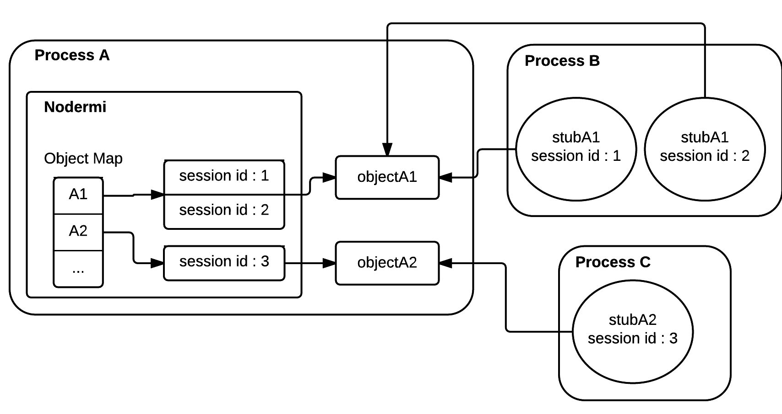
nodermi — Distributed Garbage Collection
Object Map : holds references to the objects that are remotely referenced
Each session id corresponds to a remote reference
Notes:
we use object map to keep alive objects for other processes,
discuss reference counting
Object Map : hold references to the objects that are being remotely referenced
Each record contains a list of session ids, each session id corresponds to a remote reference
When an object is passed by reference, a session id record is inserted into the object map
Objects that are remotely referenced are also referenced by the object map, so they will not be prematurely garbage collected
Stub Map : hold weak references to the stubs
The weak references are created when the stubs are created
Objects that are only referenced by weak references can be garbage collected
Stubs store session ids and their host processes’ address
When a stub is going to be garbage collected, a callback is fired to send a release message to the stub’s server with the corresponding session id

Slide 34
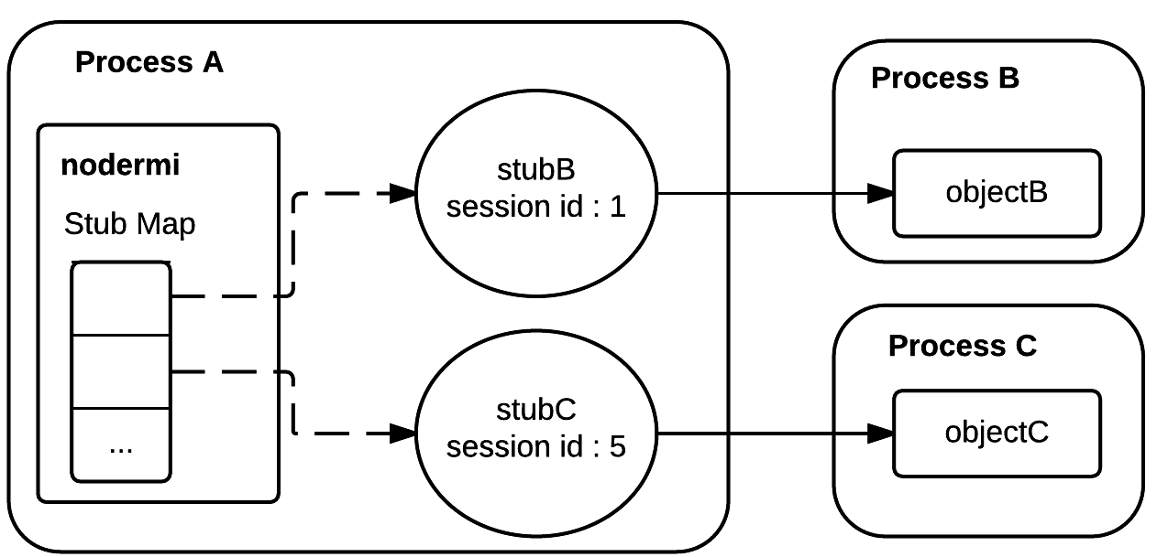
nodermi — Distributed Garbage Collection
Stub map : keeps track of if individual stubs are used in the process
Send release message when a stub is no longer reachable
Notes:
we use stub map to keep track if a remote reference is still in use or not,
if a remote reference is not in use, we send a release message to its original object’s process,
for example, process A’s stub map has all the stubs it is using, the stub map holds weak references to stubs, so the stubs can be garbage collected if they are not used in the process any more,
when stubB is garbage collected, nodermi will send a release message to process B,
when an object is not remotely referenced it will be removed from the object map
(example in previous page)
Nodermi also detects terminated processes and clean the terminated processes records in the object map
coordinate protocol
Detect terminated process and remove its remote reference records from object map
Nodermi removes a session id record upon receiving a release message
An object is removed from the object map when its reference record has no session ids.
That means all its remote references are now garbage collected
The object itself is not referenced by nodermi anymore
Nodermi also detects terminated processes and clean object map accordingly
When a process is not contacted for 60s, nodermi sends a ping message to it, if the ping message is not answered, nodermi consider the process is terminated
Session id records associated with the terminated process are cleaned
Objects are released from the object map if necessary
nodermi may create multiple references for a single object in a remote process
the release message is idempotent, it can be sent multiple times

Slide 35
nodermi — Distributed Garbage Collection
Send release message when a stub is not used anymore
Remove object from object map when all its release messages are received
Detect terminated process and remove its remote reference records from object map

Slide 36
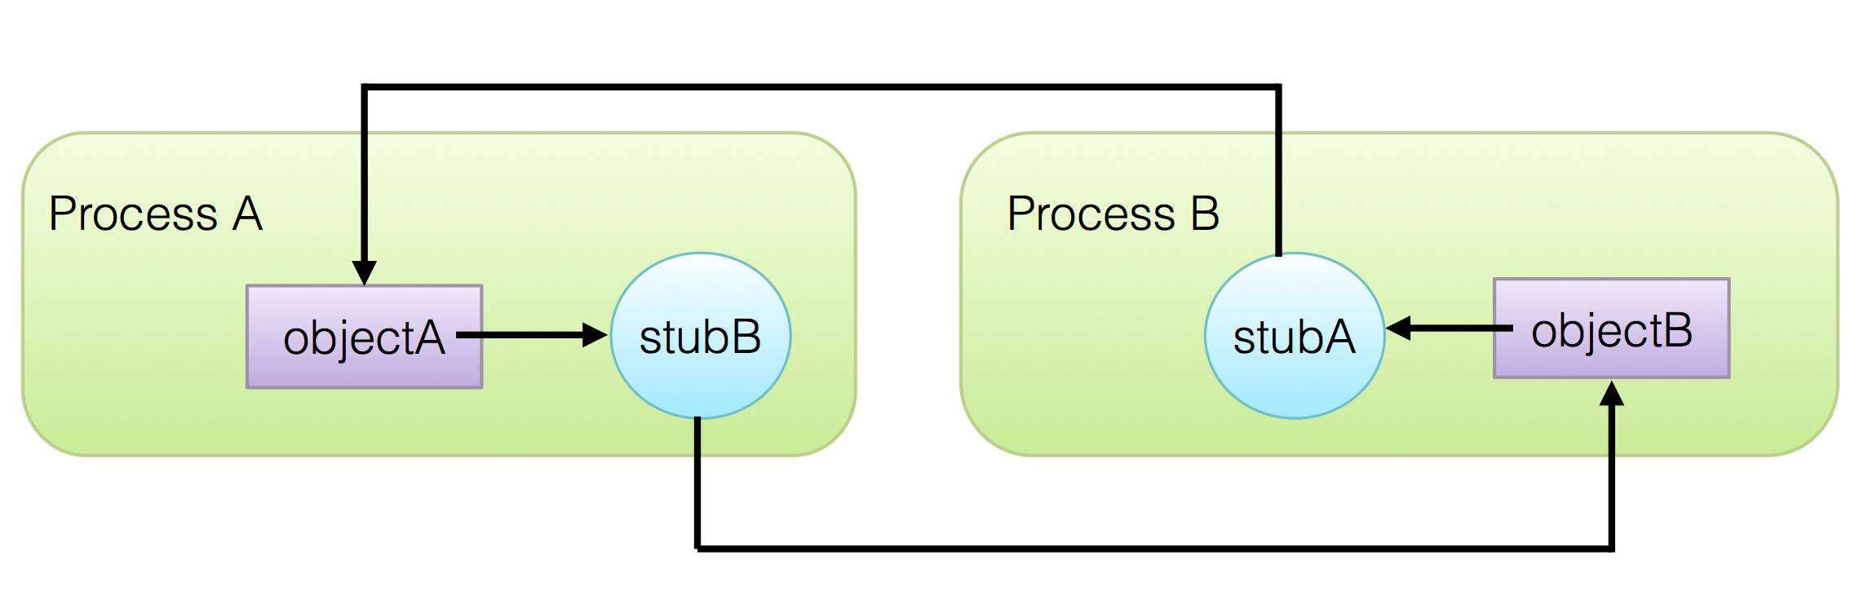
nodermi — Limitations
Does not synchronize property changes between objects and their remote references
Does not handle distributed cyclic references
Notes:
synchronize property changes are unrealistic, property reading/writing cannot block
use methods to read/write properties
let application code to handle the synchronization
cyclic references are rare
let developers to break the cycle

Slide 37
Evaluation — Goal
Evaluate scalability with respect to the number of workers
Measure cost of different kinds of applications and client libraries
Identify bottlenecks of the system
Notes:
35:00
now we discuss the evaluation of cloudbrowser2.0, the goal of the evaluation is to assess the scalability of the implementation, also we want to see the performance under different kinds of applications and client libraries, because we want to use CloudBrowser as PaaS service, we will expect all sorts of applications. finally we want to identify the bottlenecks of our system and think about ways to improve
goal ~~ : scalability , bottlenecks, different types of applications, libraries
1 slide
methodology
set up
talk about tool

Slide 38
Evaluation — Methodology
Benchmark applications
Click : simple application with no libraries
jQuery Chat : complex application with low level libraries
Angular Chat : complex application with advanced libraries
Benchmark tool
Simulate how concurrent users interact with the applications
Use an expect-like configuration to describe scenarios
Performance under different concurrent levels and different number of workers
Number of users for less than 100ms latency
Notes:
we have three benchmark applications ranging from very simple application with no library to complex application with advanced client side library .
we created a benchmark tool to simulate multiple concurrent users interact with the applications,
the benchmark tool use a expect-like configuration to describe user interactions, for each interaction, the tool also examines if the server sends back expected response.
we evaluate the system’s performance under different concurrent simulated users and different number of worker processes.
We are interested in how many users a cloudBrowser application can support, when reach a certain point, adding more concurrent users will lead to queueing effect where each user’s perceived latency increases, we are interested in providing decent user experience, there are some HCI study study shows 100ms latency is bearable for humans, so we measure how many users an application can support with less than 100ms latency,
and also we expect that, if we add more worker processes, we can get more capacity, if we double the worker processes, we can double the capacity
Server : 8*2.27GHz processors, 38GB RAM
Client : 8*900MHz processors, 16GB RAM

Slide 39
Evaluation — Testbed
Server : 2*4 2.27GHz cores, 38GB RAM
Client : 2*4 900MHz cores, 16GB RAM
Connected by 1GB ethernet
Notes:
this is the configuration of our testbed

Slide 40
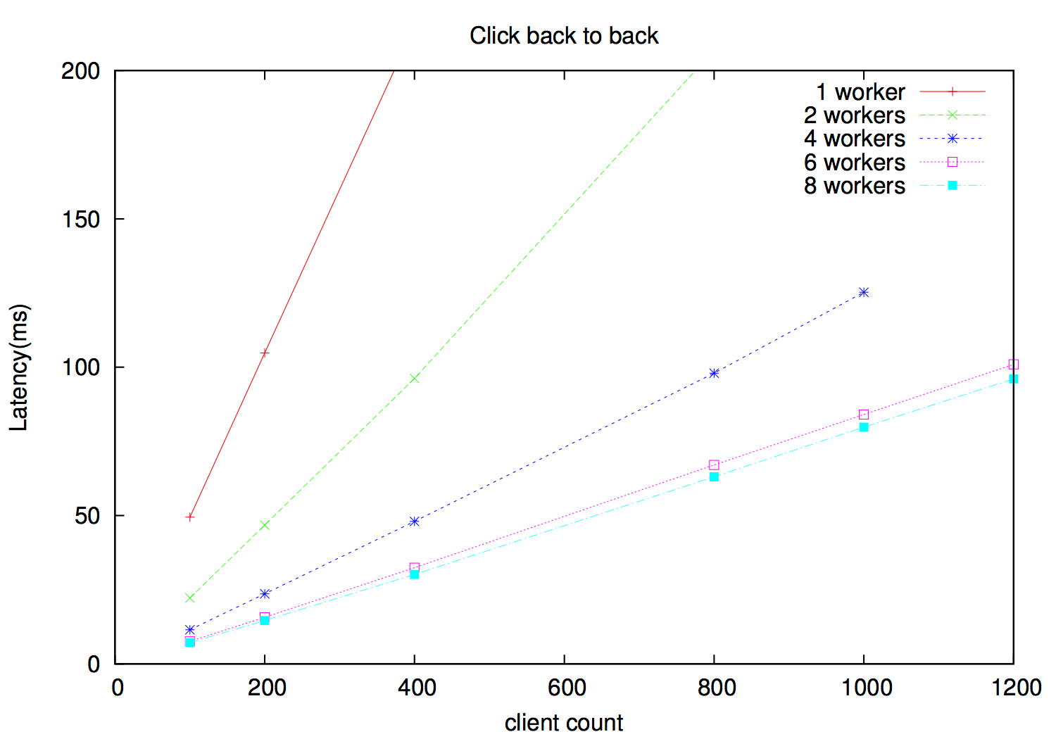
Evaluation — Click Application
1,200 clients, 96ms latency
Notes:
our first benchmark application is click application,
it listens for mouse click event and displays the number of mouse clicks
it is 5 lines javascript code, no libraries
the benchmark tool simulate users to click and wait for response and immediately click again
the system can support 1,200 concurrent clients clicking with 96ms latency
the capacity scales linearly up to 6 workers, we need to allocate tow processes for reverse proxies, so the performance for 8 workers is almost the same as 6 workers, because we only have 8 cpu cores
6 workers 11039 op/s 84.05 ms 1000 clients
6 workers 11041 op/s 100.97 ms 1200 clients

Slide 41
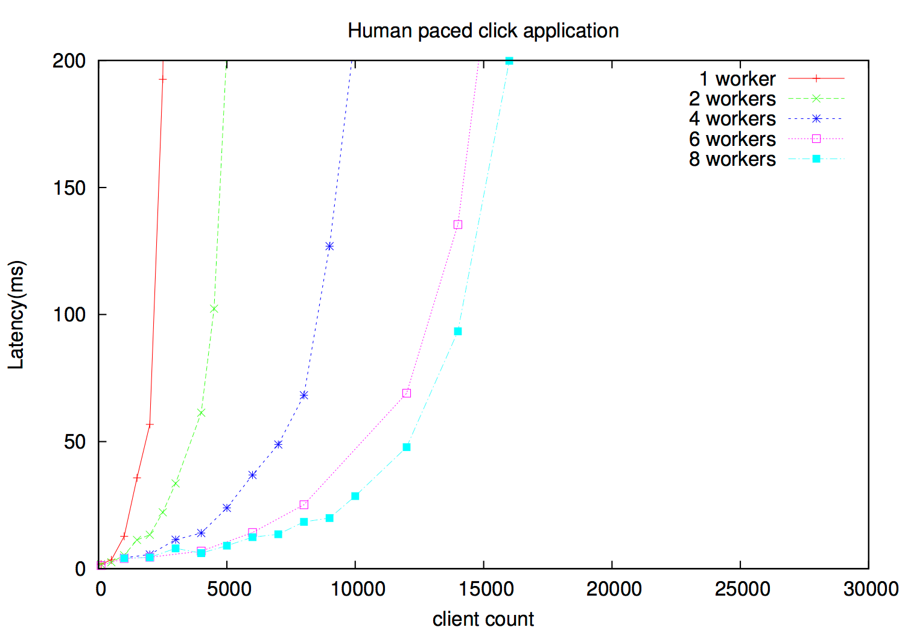
Evaluation — Click Application With Delay
1-2s random delay in between clicks to simulate “think time”
14,000 clients, 93ms latency
Notes:
the previous benchmark is not representative of real humans, because humans cannot
click very fast, we add 1-2s random delay in between clicks to simulate users’ “think time”, here is the result, now we can support
14,000 clients with 93ms latency, more then 10 times better
Add 1-2s random delay in between clicks to simulate users’ “think time”
14,000 clients, 93ms latency

Slide 42
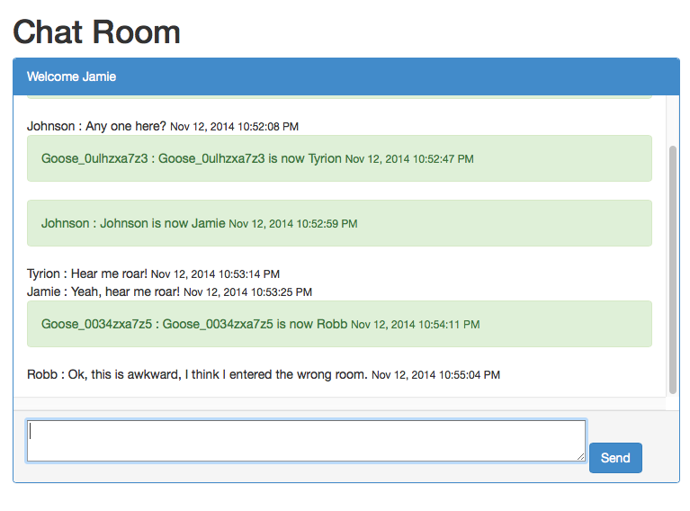
Evaluation — Chat Application
Every 5 users share one chatroom
Every user sends messages with 5-10s think time
Notes:
our second and third benchmark applications are chatroom applications,
In the chat room applications, the user can join a chatroom, set his nickname, view chat history and send chat messages.
we allocate 5 simulated users for every chatroom,
and the users sends chat messages with 5-10 seconds think time, each message has 15-20 characters
each message 15-20 characters
talk about how to use the app
chat messages need to synchronized to every user’s interface
simulate complex applications

Slide 43
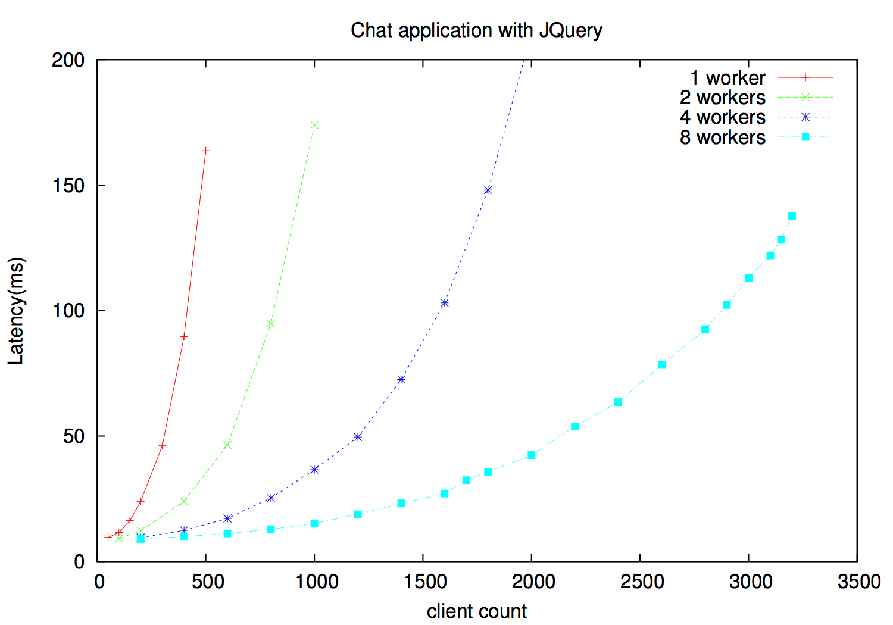
Evaluation — jQuery Chat Application
2,800 clients, 92ms latency
Notes:
this benchmark use jQuery to implement chatroom application.
we can support 2,800 concurrent users with 92ms latency
235 lines of javascript code and 35 lines HTML for this application.
Use jQuery to manipulate DOM structure
Code Size : 235 lines javascript, 35 lines HTML
2,800 clients, 92ms latency

Slide 44
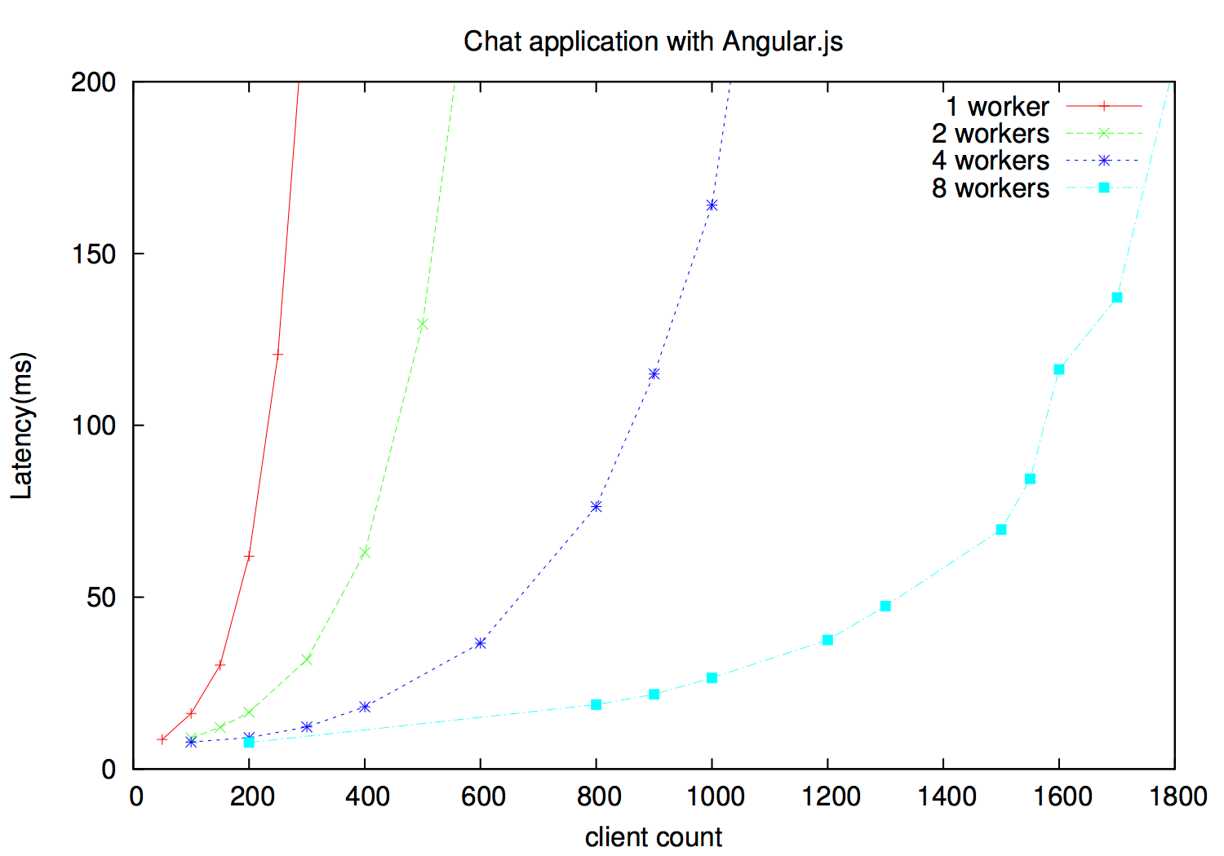
Evaluation — Angular Chat Application
1,550 clients, 84ms latency
Notes:
when we switch to a more advanced library angular.js,
we can only support 1,550 clients with 84ms latency,
but we have a smaller code base and more readable code comparing to jQuery Chat application,
the code is 69% of jqueryChat
it has 163 lines javascript, 44 lines HTML,
Code Size : 163 lines javascript, 44 lines HTML
1,550 clients, 84ms latency
jqueryChat 235 lines javascript, 35 lines HTML
2,800 clients, 92ms latency
163 JS 44HTML
nearly 50% performance lost for using this high level framework

Slide 45
Evaluation — Conclusion
Scales linearly with the number of cores on single machine
CPU time and memory used by application code becomes bottleneck
Use of high-level libraries is expensive
Master and reverse proxies are not bottleneck
Notes:
The first conclusion of our evaluation is that our implementation scales, we can add more CPU and memory to get bigger capacity,
secondly, we find out the system spends most of its CPU time and memory on the applications, especially the server side DOM implementations and javascript libraries,
we also find out advanced libraries like angular are much more expensive than simple libraries like jQuery,
it is good news for us that the system’s bottleneck is not in our architecture .
This also means we have a lot of room to improve the system’s performance, for example, the angular chat application’s performance improves 20% after an angular update, all applications improves by 30% after an update in server side DOM implementation,
we expect more performance gain by future javascript language updates and third party library updates
discuss what is the bottleneck — different applications CPU…. master is not bottleneck
see conclusion in paper ,
one of the new language feature in ECMAScript 7 proposal is native support for observing changes to ob- jects . A evaluation shows that dirty checking in Angular.js becomes 20 to 40 times faster using this feature
CloudBrowser is scalable
There is still much room to improve performance
20% performance gain from a angular update
30% performance gain from a JSDOM update
Future javascript language updates and node.js platform updates

Slide 46
Related Work — Web Frameworks
Server-centric
ZK [Chen/Yeh 2005]
ItsNat [Santamaria]
Data-driven
Meteor [Meteor Dev Group 2011]
Notes:
There are a lot of web frameworks out there,
a lot of these frameworks require developers to partition the application logic to client part and server part, the developers need to write interactive interface using javascript in client side, write server side request handling code and maintain client-server communication, these are what cloudbrowser trying to address
the frameworks we selected here are similar to our work in a way that they hide server-client communication from developers.
In particular, ZK and ItsNat are server-centric such that they store representation state in server side just like us, the applications are developed using a model that is similar to desktop GUI applications.
Unlike us, their applications are written in JAVA,
especially for ZK, the user interface is described using framework specific markup language, while in cloudbrowser, developing applications are like writing web pages, using HTML, CSS, javascript that developers are already familiar with
Meteor is a web framework that shares some similar features with cloudBrowser.
Meteor allows developers build applications using one language javascript, it also hides server-client communication details,
its programming model is tightly integrated with mongoDB and its own template engine,
while in CloudBrowser, the developers can choose the programming styles that suit their needs
Meteor does client/server model synchronization, rather than exchanging view information.
Meteor
the server-client communication is achieved by publish-subscribe,
but it is tightly integrated with mongoDB and its own template engine, it does not play well with other libraries,
you need official integration or third party plugins to use client-side libraries such as angular, in cloudBrowser you can use any library you want.
it simulates server models on client side, this could leak server side logic to client
nowadays, client-centric approaches are very popular, people use client-side MVC style libraries like angular, backbone, ember to manage user interface, and the server side are APIs to output JSON data
Google Web Toolkit is a client-centric framework , developers can write web interface as a java application, and the java application can be compiled to optimized client side javascript code, but it only focus on client side, it does not cover client-server communication

Slide 47
Related Work — Thin Clients
VNC [Richardson 1998]
X11 [Gettys/Scheifler 1986]
VMWare Horizon
Citrix XenDesktop
Notes:
Compare to these thin-client systems, cloudBrowser does not actually do rendering in the server side, thus it is much more light-weighted
MWare’s Horizon product provides a way to see the user interface of actual virtual machines via a browser, with its BLAST protocol

Slide 48
Related Work — RPC Frameworks
Dynamic languages
Dnode [Halliday 2011] for Node.js
Pyro [Jong 1998] for Python
Druby [Seki 2012] for Ruby
Static languages
Network objects [Birrell, et al. 1994] for Modula-3
Java RMI [Downing 1998] for Java
Language independent
CORBA [Object Management Group 1991]
Notes:
Now we discuss RPC frameworks related to nodermi,
pyro is a RPC framework for python, druby is a RPC framework built in ruby standard library, unlike nodermi , pyro and druby require developers to explicitly tell the framework an object needs to be passed as a remote reference,
also in druby, ,it is developers’ responsibility to reference the objects that are remotely referenced so that they do not get prematurely garbage collected, while nodermi handles these things transparently,
dnode is also developed for node.js, but it has zig-zag problem
for frameworks in static languages, objects need to implement specific interfaces to be remotely referenced, these frameworks also rely on type system in the programming languages to determine (which interface a remote object inherit ) which methods are available in a stub. Another major difference is the stubs in these frameworks do not have properties, they only have methods, the properties of the remote objects can only be accessed by method invocations, in nodermi, stubs have properties and can be directly accessed
it is worth mentioning that
nodermi’s distributed garbage collection algorithm is similar to the network objects, the major difference is how they count remote references
network objects create one stub per remote object in a process, nodermi does not have this restriction
do not need to do synchronization when releasing a remote object
we also want to mention CORBA,
CORBA [Object Management Group 1991]
Common Object Request Broker Architecture
it is a standard that defines object-oriented RPC between systems on different OSs , programming languages. CORBA requires IDL(interface definition language) to define the interface of remote objects, and implement IDL to object mappings, in nodermi, stubs are dynamically generated, we do not need to pre-define remote objects’ interfaces
Except for dnode, all these frameworks are sychrounous, remote method invocations block until the remote processes complete the execution of the original methods.
(pyro : pyro lacks garbage collection mechanism, objects that passed to remote methods are kept forever )

Slide 49
Conclusion
CloudBrowser as a PaaS Service
Scalable implementation of CloudBrowser
Refined application deployment models
Secure access to framework objects
Flexible node.js RPC framework : nodermi
Helped us leverage existing code base
Standalone framework, can be applied to other node.js projects
Notes:
in my thesis, I presented cloudBrowser2.0, a scalable implementation of cloudBrowser, with refined application deployment models, Secure access to framework objects,
As part of the implementation, we also created a flexible node.js RPC framework, nodermi

Slide 50
Thank you!

Slide 51
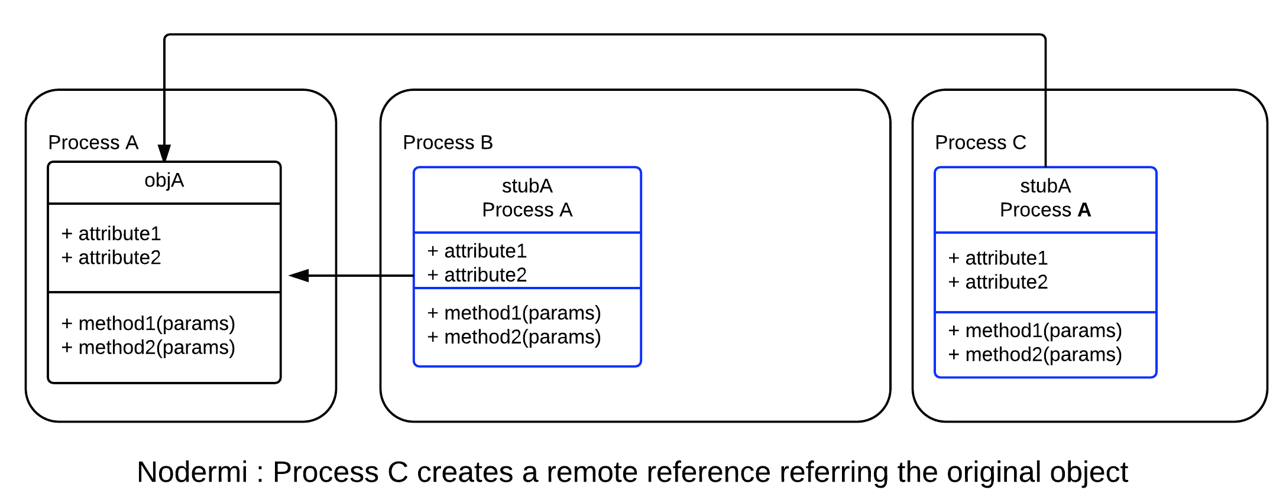

Slide 52
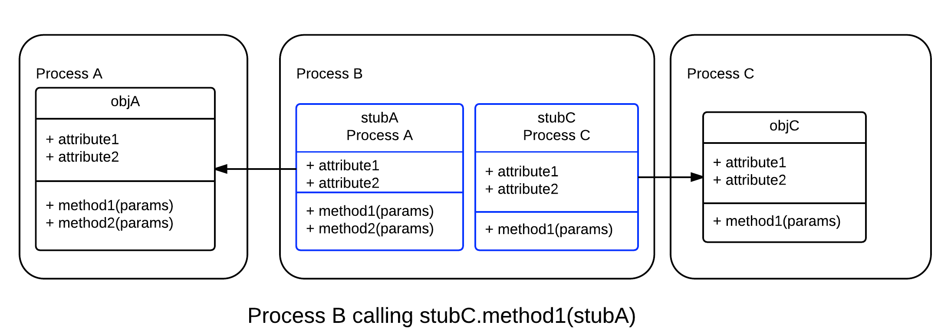
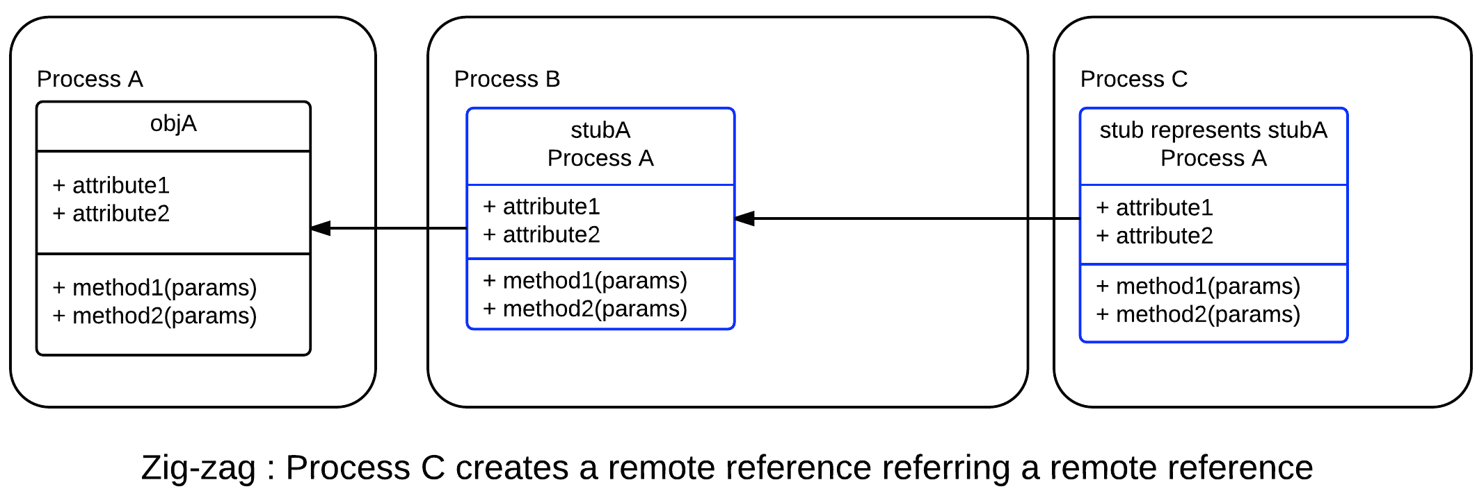

Slide 53
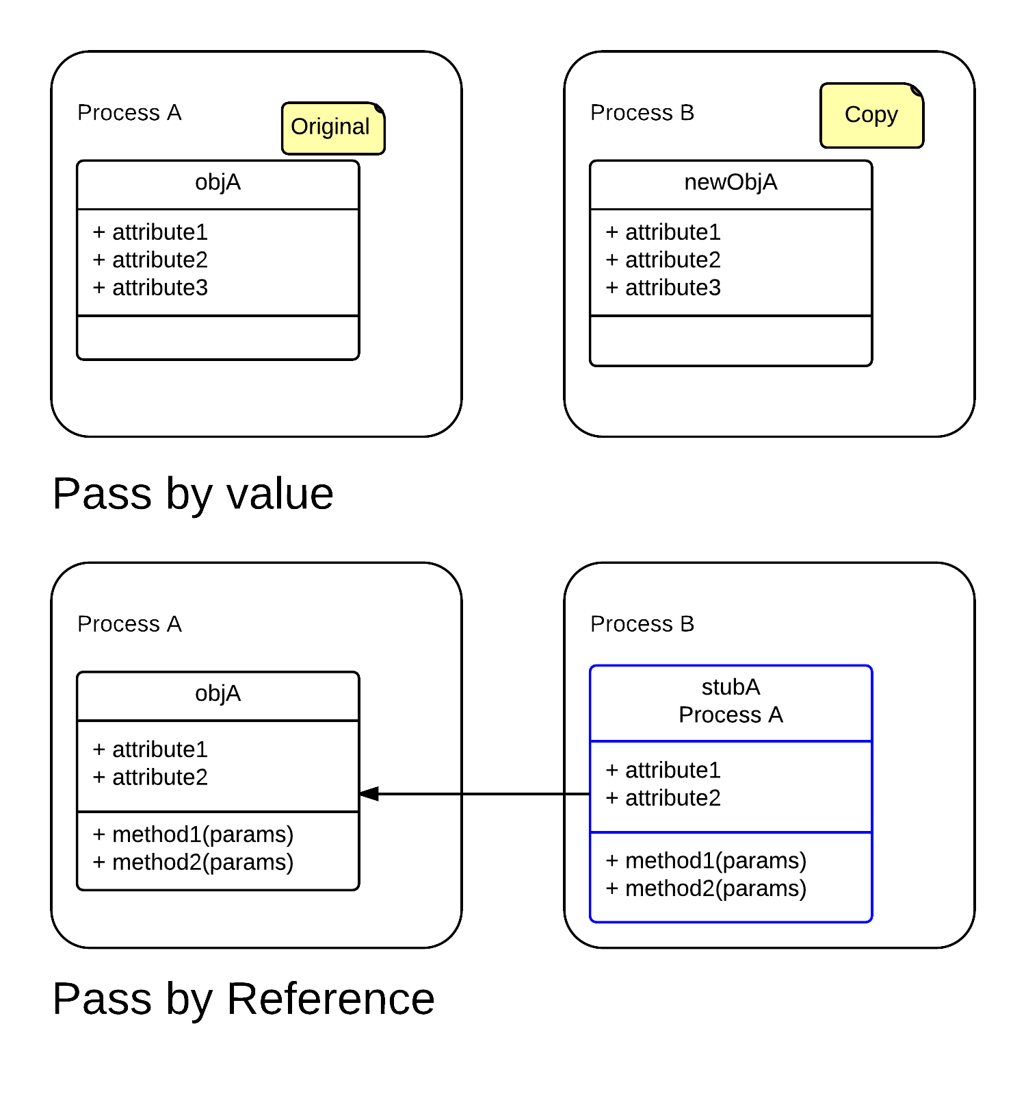

Slide 54
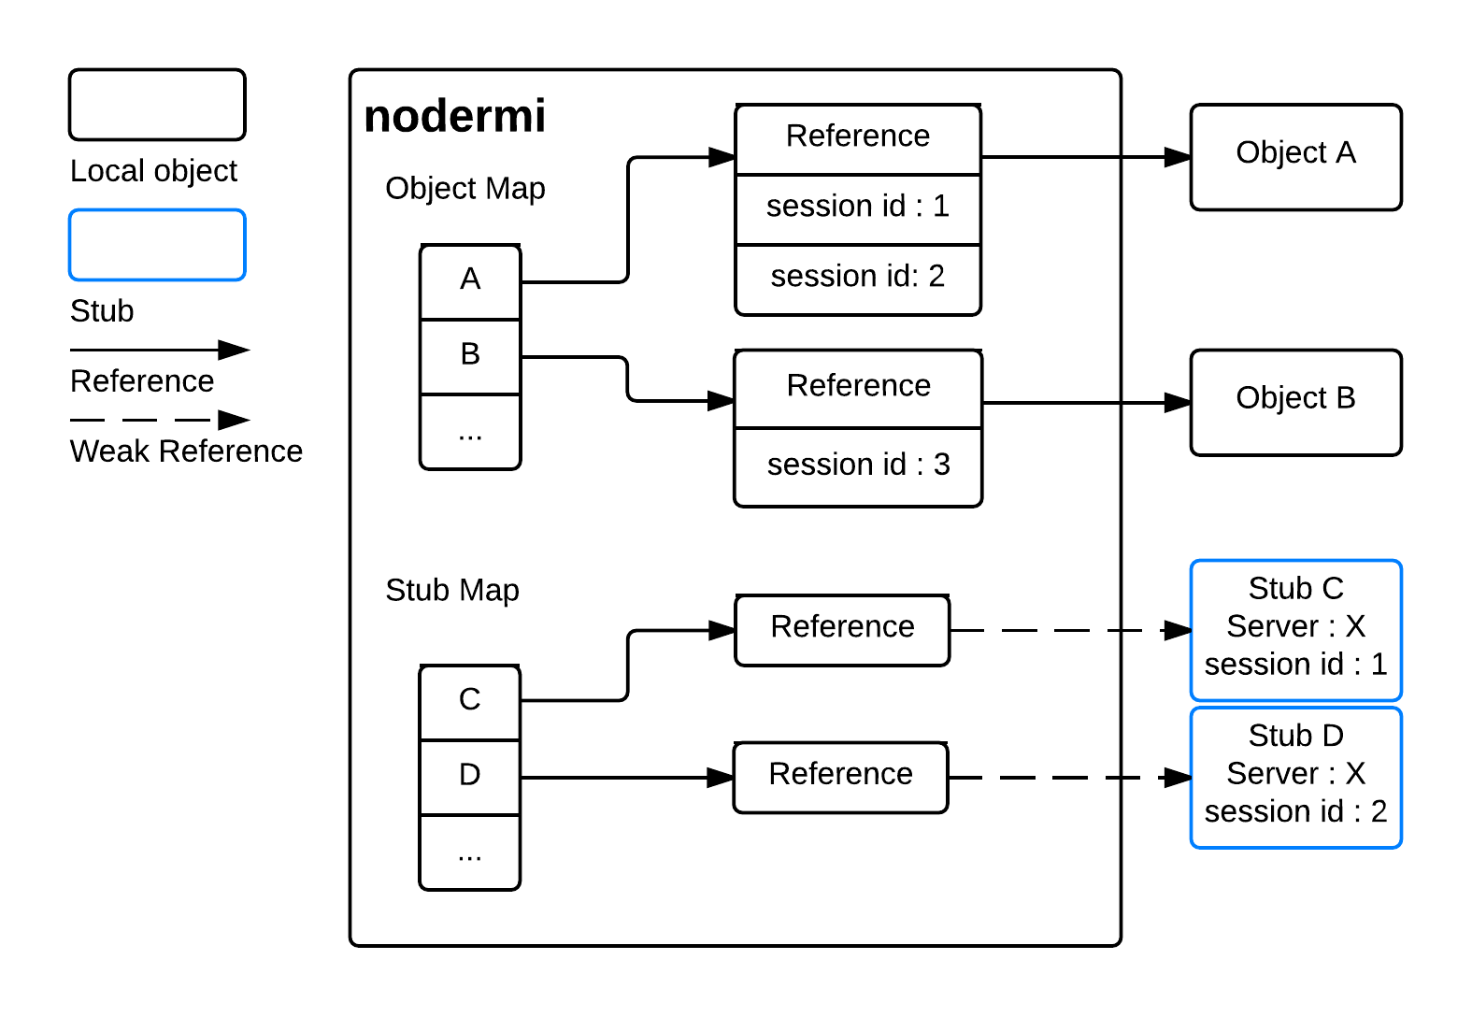

Slide 55
Web Application Development

